Slide 1


vs
Target & Walmart: Stores at Risk of Closure by Review Analysis?
CIS 509 | 03/05/2025
Group 5 - Edselmo Biondi, Ibtehaj U Deen, Kavya Murugan, Piyush Gautam, Vineeth Kalyanaraman

Slide 2
Content to be Covered
Problem Statement
Problem Solving Methodology
The Business Impact
Exploratory Data Analysis (EDA)
ML Models
Sentimental Analysis
BERT Analysis
Results & Business Insights

Slide 3

The Challenge of Retail Store Closures
Retail Industry at a Glance
U.S. retail market size: $5.5 trillion
Walmart: 4,616 stores, $400B+ annual revenue
Target: 1,956 stores, $100B+ annual revenue
Ongoing challenge: Store closures due to underperformance & shifting market trends
Current Approach
Decisions based on lagging indicators (revenue decline, lease expirations, low foot traffic)
Results: Last-minute closures → Brand damage, layoffs, & financial losses
Store Closure: Going Concern?

Slide 4
The Challenge of Retail Store Closures
Problem Statement
How can Walmart and Target address the ongoing challenge of identifying going concern issues early, instead of relying on lagging financial indicators that lead to reactive store closures, potential brand damage, and economic losses?
Helping Walmart & Target with Stores at Risk, but How?

Slide 5

Methodology We Applied to Solve the Underlying Problem
Is_Open is our target variable. 1 means store is still functional, 0 means store is closed
Independent variables are: (stars_x, stars_y, useful, compound)
ML Models (Pick one best model after hypertuning)
NLP
Incorporating Limitations
Recommendations
It is a Binary Classification prediction problem.
Notes:
stars_x is when person’s rating, stars_y is store’s rating, compound is sentiment score, useful is how useful a review is (no. of ppl who rate your review useful)

Slide 6


Why This Matters: The Business Impact
(1)
Proactive Store Management
(2)
Competitive Market Intelligence
(3)
Brand Reputation & Customer Trust
(4)
Cost Savings & Resource Optimization
(5)
Customer-Centric Business Strategy
(6)
Cost Savings & Resource Optimization
Data-Driven Decisions to Sustainable Retail Stores

Slide 7


Walmart: Data Set Explanation
We have used Yelp Dataset which contained various Business information with respective reviews and user information.
We have used 1.5 million rows and there are 275 stores from where we got data across the country
Florida has highest number of stores with count of 65
From the initial analysis we were able to get the following information:
Average review length was around 114
Number of Unique words in the data for walmart was 10305
Number of Unique users were 1449
A large-scale, nationwide view of Walmart store reviews and customer feedback.

Slide 8

Target: Data Set Explanation
We have used Yelp Dataset which contained various Business information with respective reviews and user information.
We have used 1.5 million rows and there are 275 stores from where we got data across the country
Pennsylvania and Florida has highest number of stores with count of 29
From the initial analysis we were able to get following information:
Average review length was around 102
Number of Unique words in the data for walmart was 8700
Number of Unique users were 1259
Comprehensive insights into Target store performance through customer reviews nationwide.

Slide 9
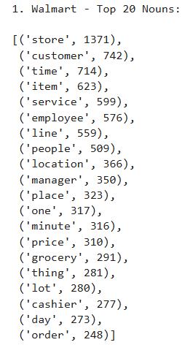
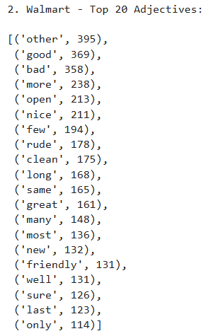
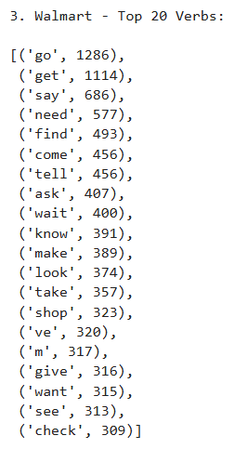
Analyzing Walmart Reviews: Key Language Insights
Average_stars: 2.26
Average_compound: 0.16
Unique Words: 10,305
Avg Review Length: 113.67
Total Tokens: 74,263
Unique Users: 1,449
This analysis presents Walmart’s top nouns, adjectives, verbs, and key review metrics, revealing common language patterns in customer feedback.

Slide 10
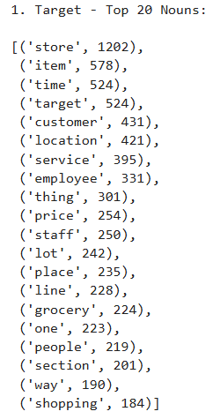
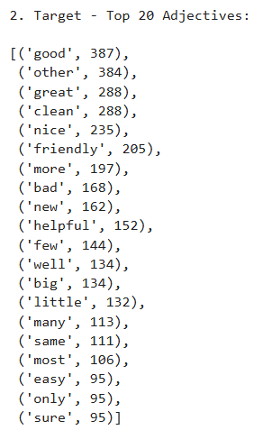
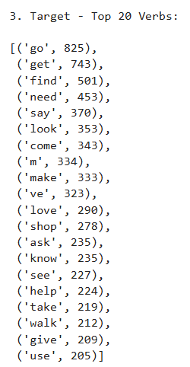
Analyzing Target Reviews: Key Language Insights
Average_stars: 3.22
Average_compound: 0.47
Unique Words: 8,700
Avg Review Length: 102.02
Total Tokens: 56,633
Unique Users: 1,259
This analysis presents Target’s top nouns, adjectives, verbs, and key review metrics, revealing common language patterns in customer feedback.

Slide 11
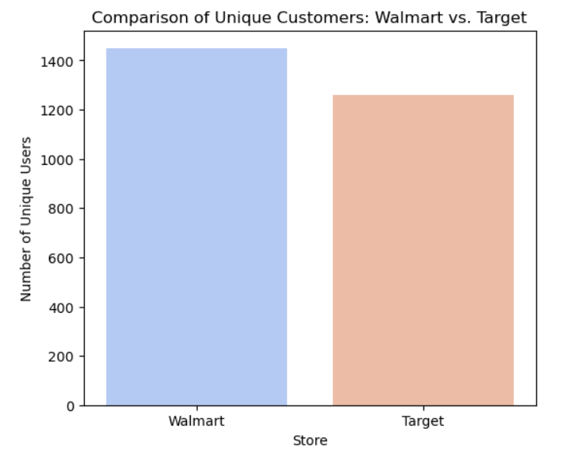
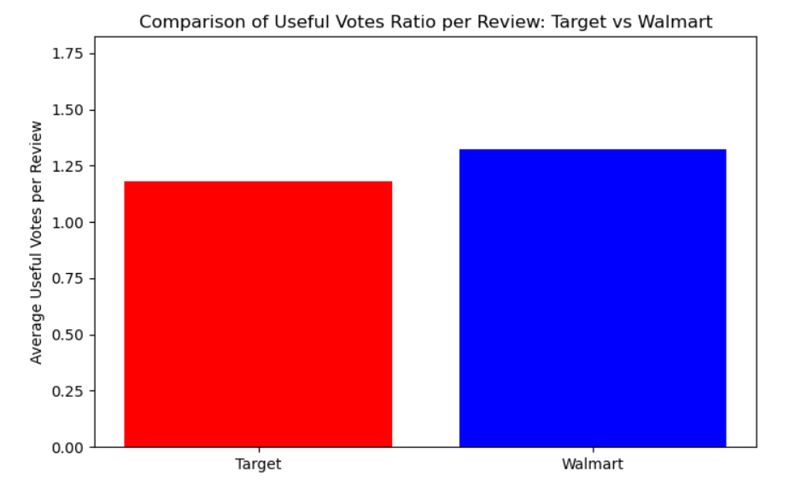
Comparison: Unique Customers & Useful Votes
Walmart has marginally better avg useful votes per review
Unique Users for Walmart: 1449
Unique Users for Target: 1259
Walmart engages more unique users, while maintaining slightly higher review usefulness.

Slide 12
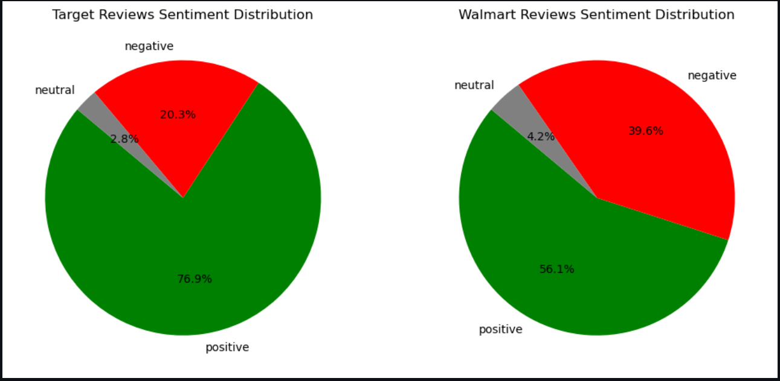
Analyzing Sentiment Distribution: Target vs Walmart
 | Market Review Totals
Sentiment
Positive | 1048 | 900
Negative | 277 | 635
Neutral | 38 | 68
Total | 1363 | 1603
Target's reviews are predominantly positive, while Walmart shows a higher share of negative feedback, highlighting a contrast in customer experiences.
Walmart has a greater volume of total reviews, but a larger portion is negative compared to Target, indicating potential areas of concern.
Target enjoys stronger positive sentiment, while Walmart faces significantly higher negative feedback.

Slide 13
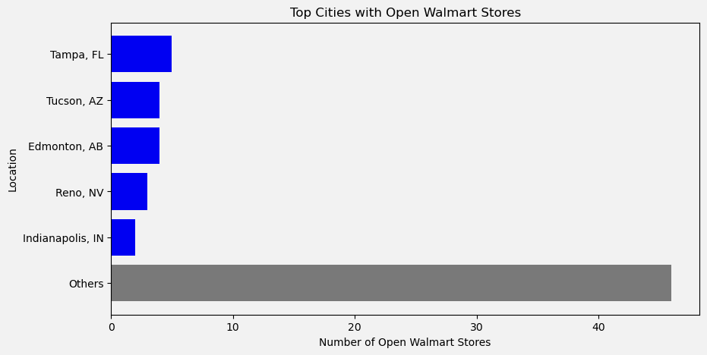
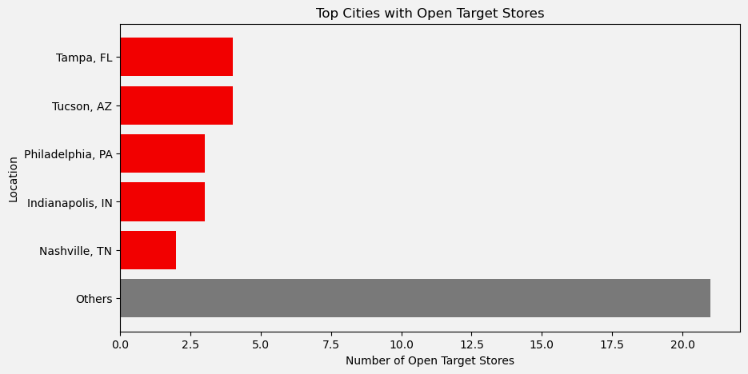

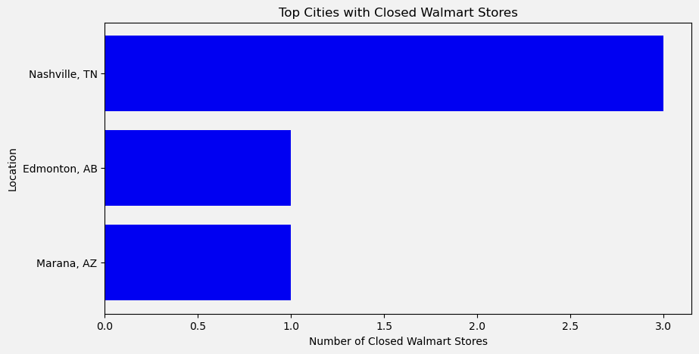
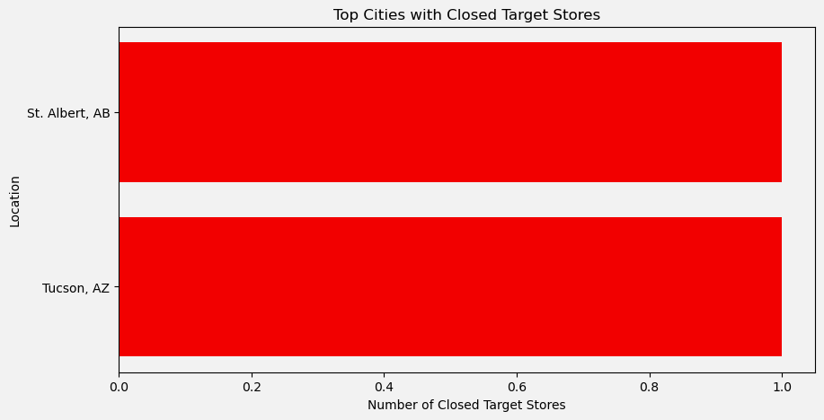
Number of Open Stores: Target vs Walmart
Open | 64 | 37
Closed | 5 | 2
Total Stores | 69 | 39
Closure Percentage | 7.81% | 5.41%
Walmart shows a higher store closure rate than Target, signaling greater operational challenges.

Slide 14
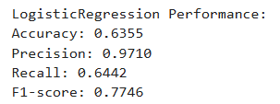
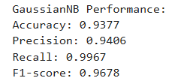
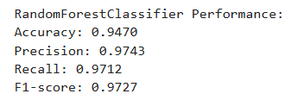
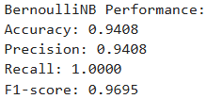
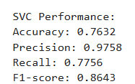

Walmart: ML Models Before HyperTurning
Logistic Regression
NB
Random Forest
Bernoulli NB
SVM
Random Forest achieved the highest accuracy (94.7%), outperforming other models. Hyperparameter tuning may further enhance its performance.

Slide 15
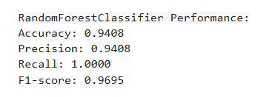
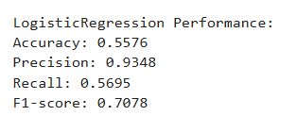


Walmart: ML Models After HyperTurning
After hyperparameter tuning, Random Forest maintained a high accuracy (94.08%), while Logistic Regression dropped to 55.7%, confirming Random Forest as the superior model.

Slide 16
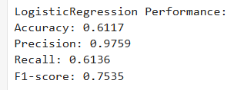
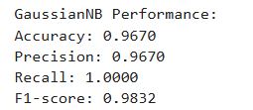
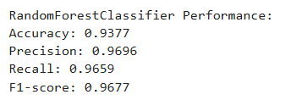
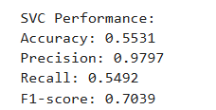
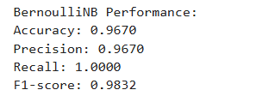
Target: ML Models Before HyperTurning
Logistic Regression
NB
Random Forest
SVC
Bernoulli NB
Before hyperparameter tuning, Random Forest (93.77%) and Naïve Bayes models (96.7%) showed the highest accuracy, while Logistic Regression (61.1%) and SVC (55.3%) underperformed.

Slide 17
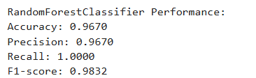
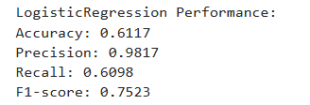
Target: ML Models After HyperTurning
After hyperparameter tuning, Random Forest achieved the highest accuracy (96.7%), while Logistic Regression remained significantly lower at 61.1%, reinforcing Random Forest as the superior model.

Slide 18

Why Random Forest is the Best Model for Walmart & Target?
Highest Accuracy after Hypertuning
Handles Noisy and Imbalanced Data Well
Captures Complex Patterns in Text-Derived Data
Random Forest outperformed other models, making it the ideal choice for predicting store closures from complex review data.

Slide 19
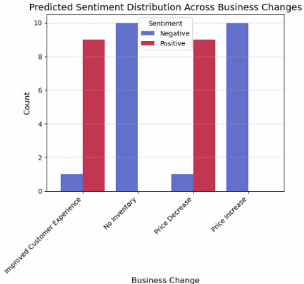
Walmart - Sentimental Analysis
If the business apply the changes to improve their current scenarios as per the sentiment analysis
1. Improved Customer Experience
The chart shows a somewhat mixed sentiment, with both negative and positive counts. This might indicate that while many customers appreciate service enhancements, others may have had lingering issues or expectations not met.
2. No Inventory
Predominantly Negative sentiment, though there’s still a notable positive portion. Customers are generally frustrated by stock-outs, but some feedback may remain positive due to other factors (e.g., helpful staff, alternative products).
3. Price Decrease
Strongly Positive sentiment, with virtually no negative feedback. Lower prices are a clear win for most customers, reinforcing that cost reductions typically boost satisfaction.
4. Price Increase
Primarily Negative sentiment, with a smaller positive component. While higher prices tend to upset customers, some may perceive added value or better quality, hence the few positive reviews.

Slide 20
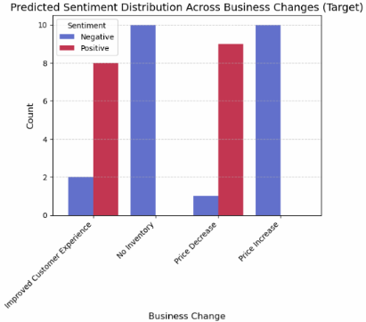
Target - Sentimental Analysis
If the business apply the changes to improve their current scenarios as per the sentiment analysis
Improved Customer Experience
The chart shows a predominantly Positive response. This suggests that initiatives enhancing customer interactions or service quality are very well-received.
No Inventory
The chart indicates a mostly Negative response. Customers are generally dissatisfied when items are unavailable, highlighting the need for strong inventory management.
Price Decrease
Lowering prices generates largely Positive feedback, though some negative reactions may occur if other factors (like quality) aren’t maintained.
Price Increase
Raising prices triggers a primarily Negative response, reinforcing that higher costs often require added value or justification to maintain customer satisfaction.

Slide 21
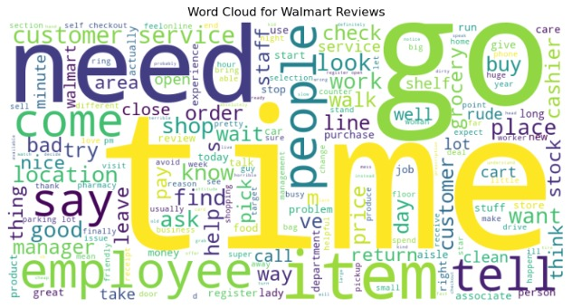
Walmart - Word Cloud

Slide 22
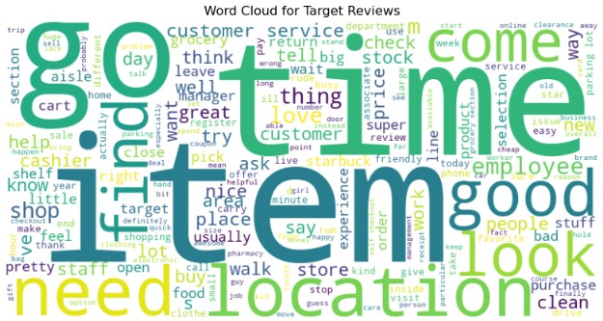
Target - Word Cloud

Slide 23
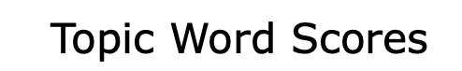
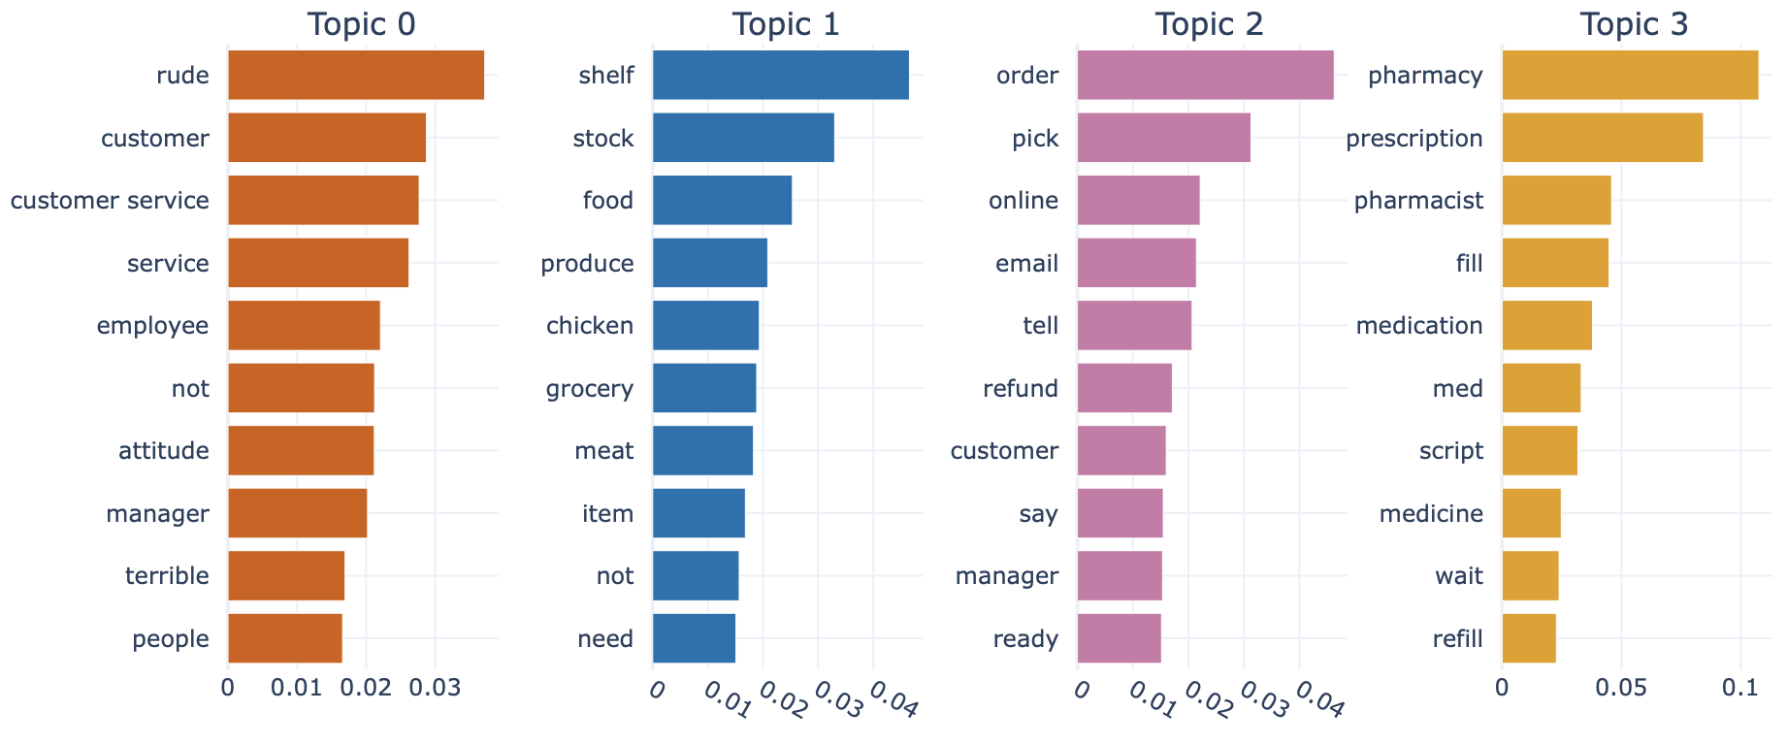
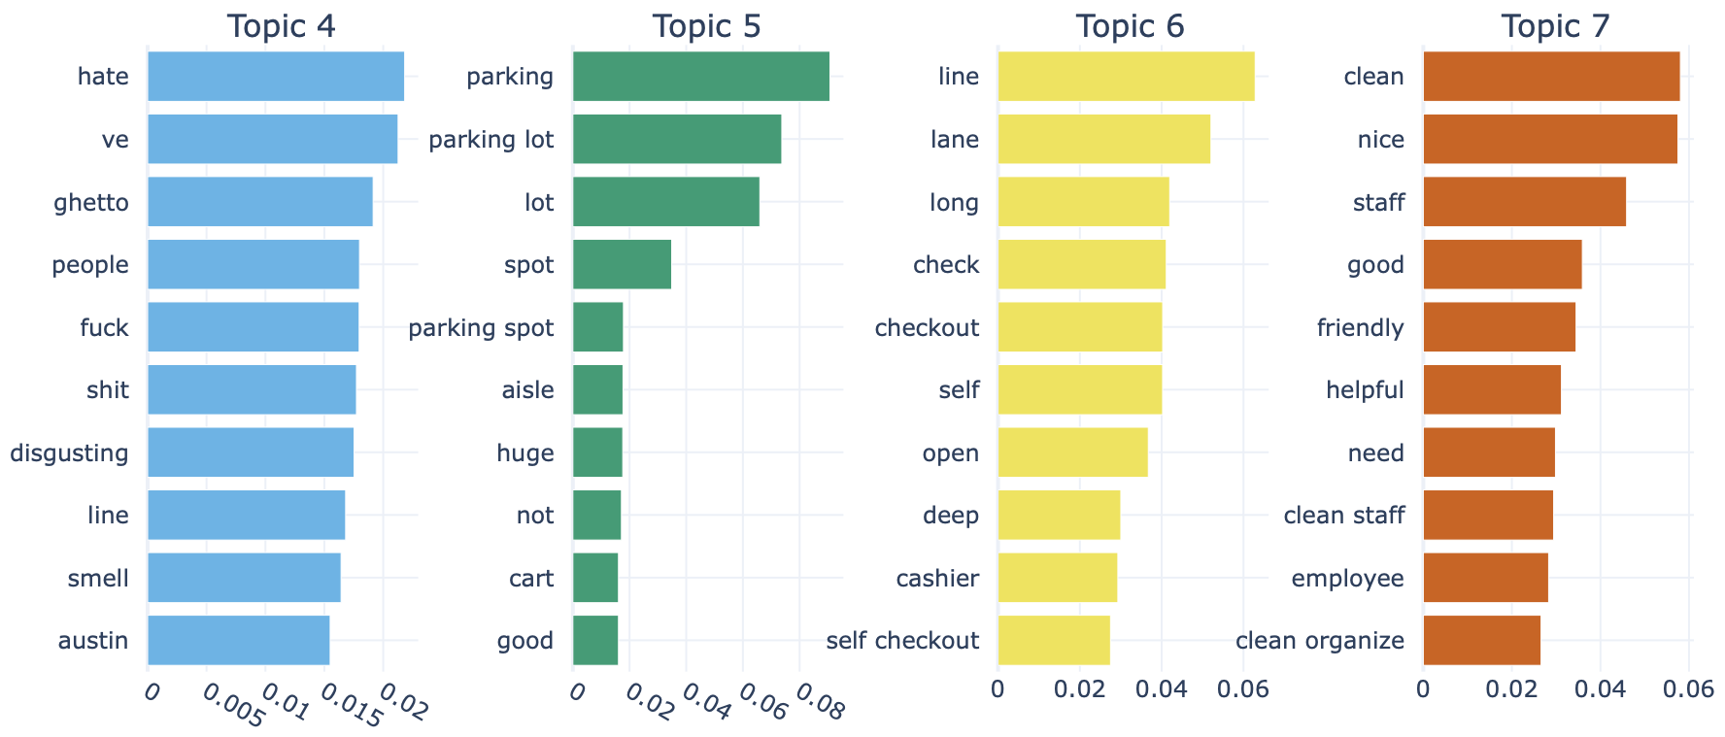
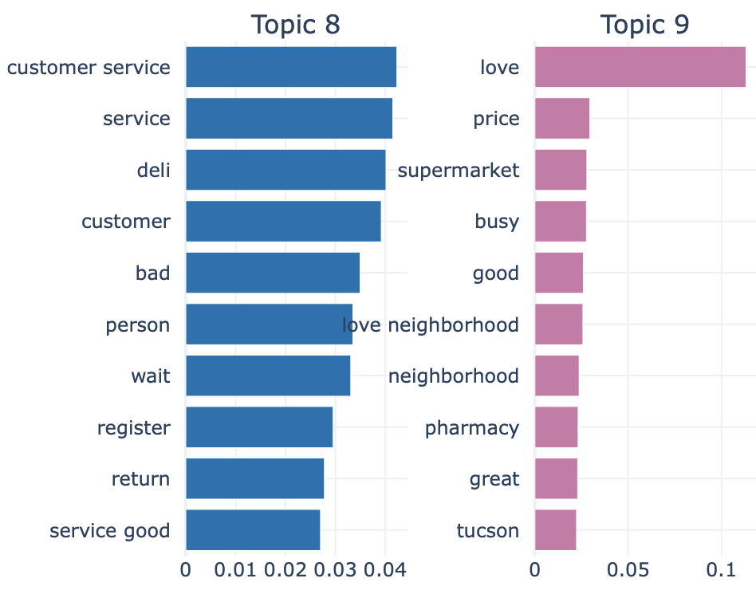
Walmart: BERT Analysis (1/6)
We identified 10 major recurring themes from Walmart customer reviews:
Service Issues: rude staff, poor customer service (Topic 0, Topic 8)
Stock Shortages: empty shelves, unavailable products (Topic 1)
Online Order Problems: pickup delays, refund issues (Topic 2)
Pharmacy Complaints: long waits, prescription errors (Topic 3)
Store Environment: dirty, unpleasant atmosphere (Topic 4)
Parking Challenges: crowded, insufficient space (Topic 5)
Checkout Delays: long lines, slow self-checkout (Topic 6)
Cleanliness & Organization: messy, unorganized stores (Topic 7)
Deli Counter Issues: slow service, incorrect orders (Topic 8)
Positive Mentions: minimal, focused on “love” and “price” (Topic 9)
Recurring themes indicate operational challenges that serve as early warning signs for store performance risks.
Notes:
Additional Insights (for your notes or speaking points):
🔹 Dominance of Service-Related Complaints: Topics 0 and 8 both emphasize customer service and staff behavior, signaling that people are repeatedly frustrated by interactions with employees — this can be a leading indicator of operational decline.
🔹 Operational Gaps Across the Board: There’s a spread across inventory management (Topic 1), order fulfillment (Topic 2), pharmacy services (Topic 3), and store maintenance (Topics 4, 7). This suggests that store problems are not isolated, but systemic.
🔹 Facilities and Experience Matter: Topics on parking (Topic 5) and checkout (Topic 6) highlight how even external or logistical factors influence customer satisfaction.
🔹 Minimal Positive Sentiment: Topic 9 has small positive mentions ("love", "price") but is insignificant compared to the weight of negative topics. This imbalance could correlate with stores at higher risk.
Additional Insights (for your notes or speaking points):
🔹 Dominance of Service-Related Complaints: Topics 0 and 8 both emphasize customer service and staff behavior, signaling that people are repeatedly frustrated by interactions with employees — this can be a leading indicator of operational decline.
🔹 Operational Gaps Across the Board: There’s a spread across inventory management (Topic 1), order fulfillment (Topic 2), pharmacy services (Topic 3), and store maintenance (Topics 4, 7). This suggests that store problems are not isolated, but systemic.
🔹 Facilities and Experience Matter: Topics on parking (Topic 5) and checkout (Topic 6) highlight how even external or logistical factors influence customer satisfaction.
🔹 Minimal Positive Sentiment: Topic 9 has small positive mentions ("love", "price") but is insignificant compared to the weight of negative topics. This imbalance could correlate with stores at higher risk.
Additional Insights (for your notes or speaking points):
🔹 Dominance of Service-Related Complaints: Topics 0 and 8 both emphasize customer service and staff behavior, signaling that people are repeatedly frustrated by interactions with employees — this can be a leading indicator of operational decline.
🔹 Operational Gaps Across the Board: There’s a spread across inventory management (Topic 1), order fulfillment (Topic 2), pharmacy services (Topic 3), and store maintenance (Topics 4, 7). This suggests that store problems are not isolated, but systemic.
🔹 Facilities and Experience Matter: Topics on parking (Topic 5) and checkout (Topic 6) highlight how even external or logistical factors influence customer satisfaction.
🔹 Minimal Positive Sentiment: Topic 9 has small positive mentions ("love", "price") but is insignificant compared to the weight of negative topics. This imbalance could correlate with stores at higher risk.

Slide 24
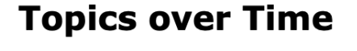
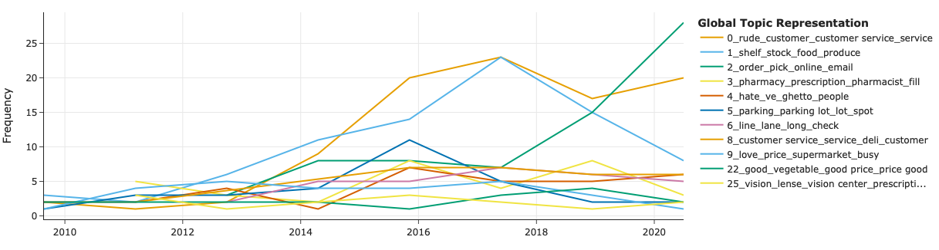
Walmart: BERT Analysis (2/6)
How Customer Complaints Have Shifted Over Time
Rude Customer Service (Topic 0) – Sharp increase after 2014, peaking near 2018, highlighting persistent dissatisfaction with staff and service quality.
Stock & Inventory Issues (Topic 1) – Gradual, consistent growth until 2017, signaling ongoing challenges in product availability.
Online Order & Pickup Problems (Topic 2) – Noticeable surge post-2016, correlating with the rise of e-commerce services like pickup and delivery.
Pharmacy Complaints (Topic 3) – Steady presence, indicating recurring prescription service issues across years.
Other Topics – Remain relatively stable with lower frequency, such as Parking (Topic 5) and Checkout Delays (Topic 6).

Slide 25
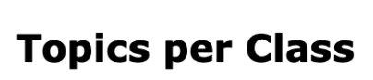
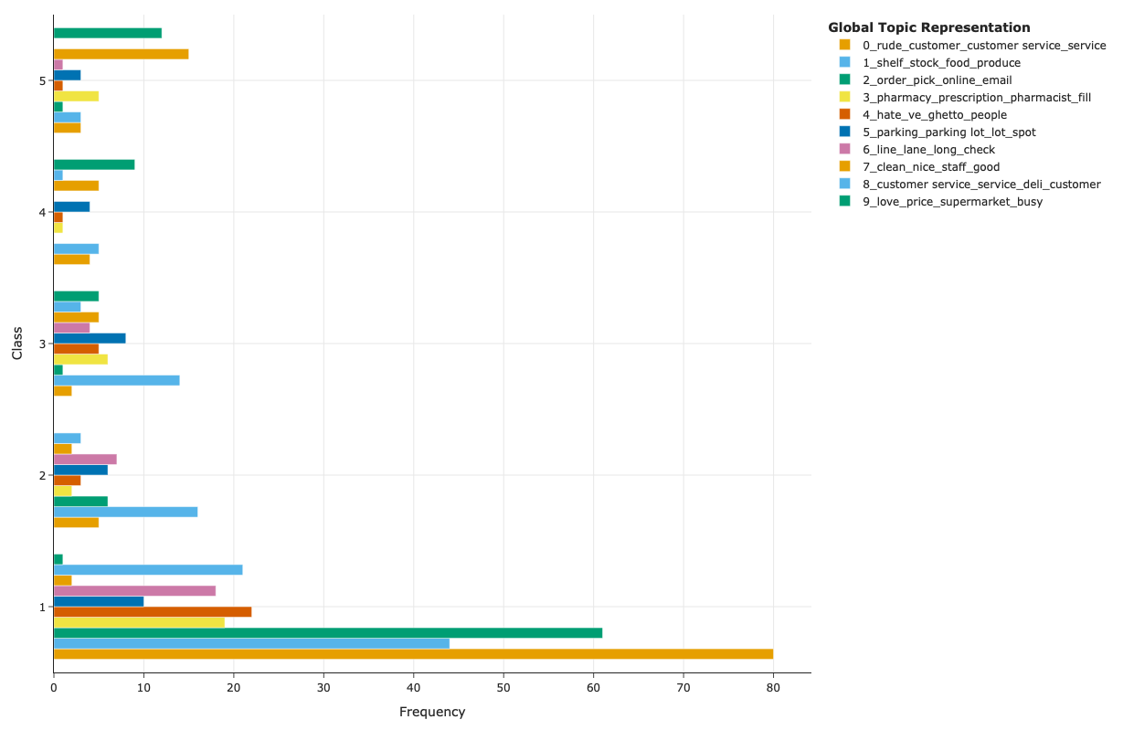
Walmart: BERT Analysis (3/6)
Distribution of Topics Across Review Classes
1-star ratings dominates the dataset, with the highest frequency of reviews mentioning:
Rude Customer Service (Topic 0)
Online Order Issues (Topic 2)
Positive Mentions (Topic 9) (though less frequent than negative topics).
Higher Star Ratings (4 & 5) show a more balanced mix of topics but with lower frequencies, indicating fewer but potentially more severe complaints.
Stock Issues (Topic 1) and Parking Problems (Topic 5) appear consistently across classes, reinforcing them as widespread, ongoing problems.

Slide 26
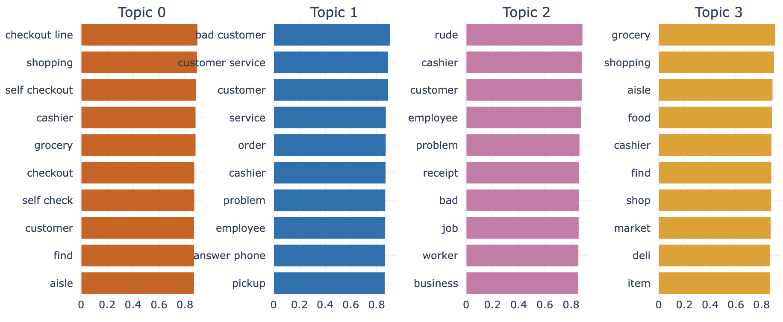
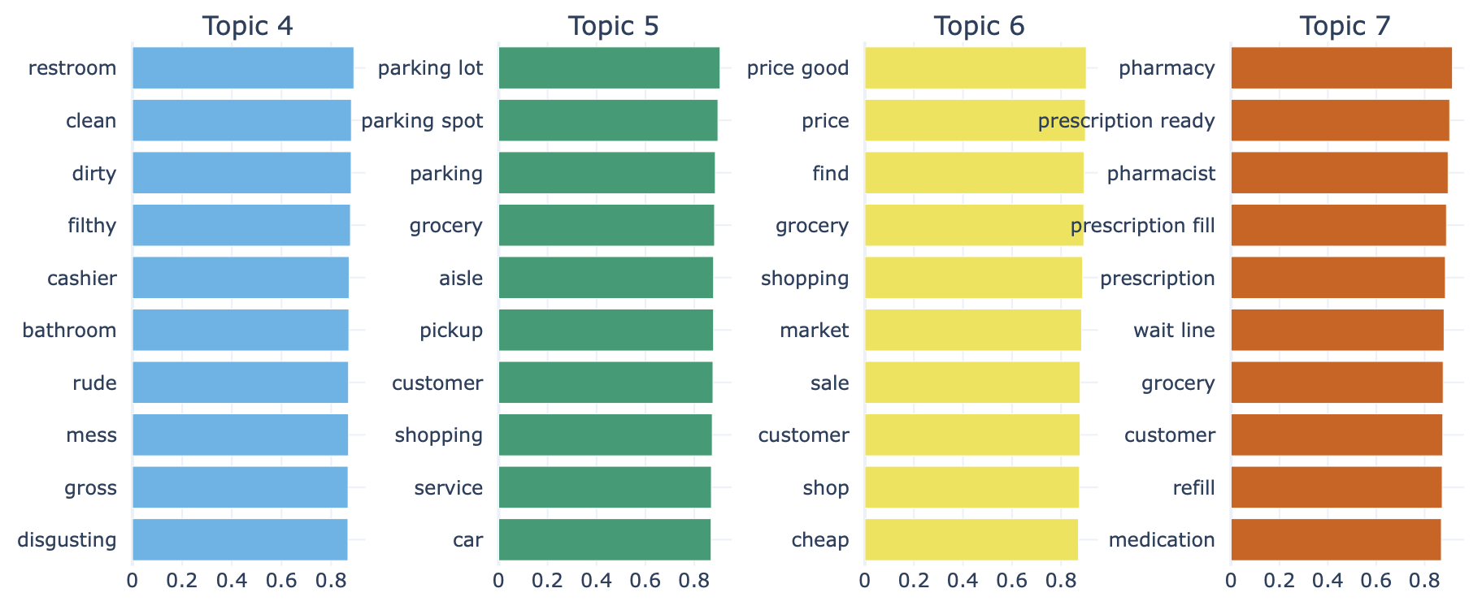
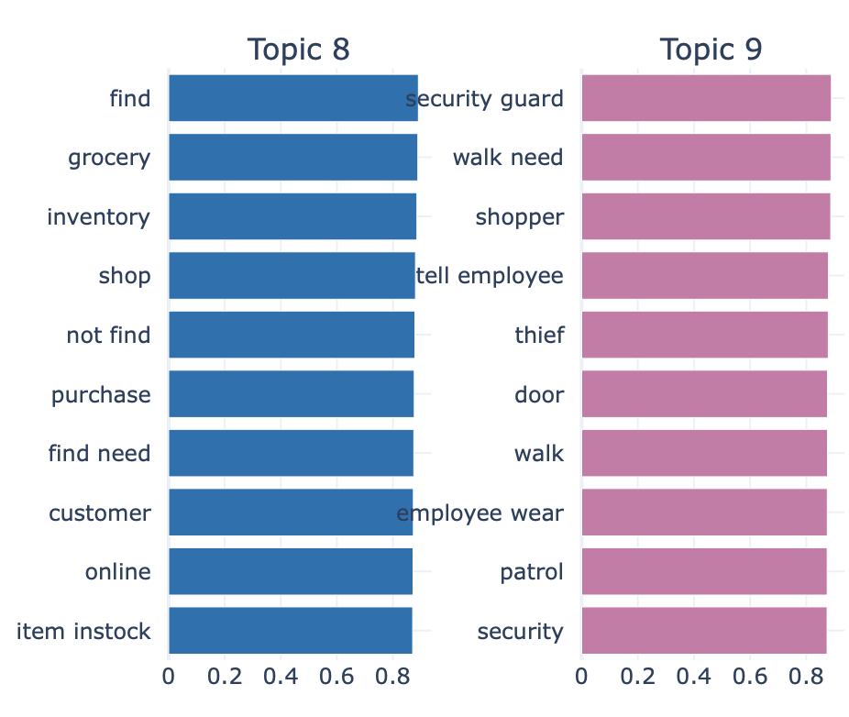
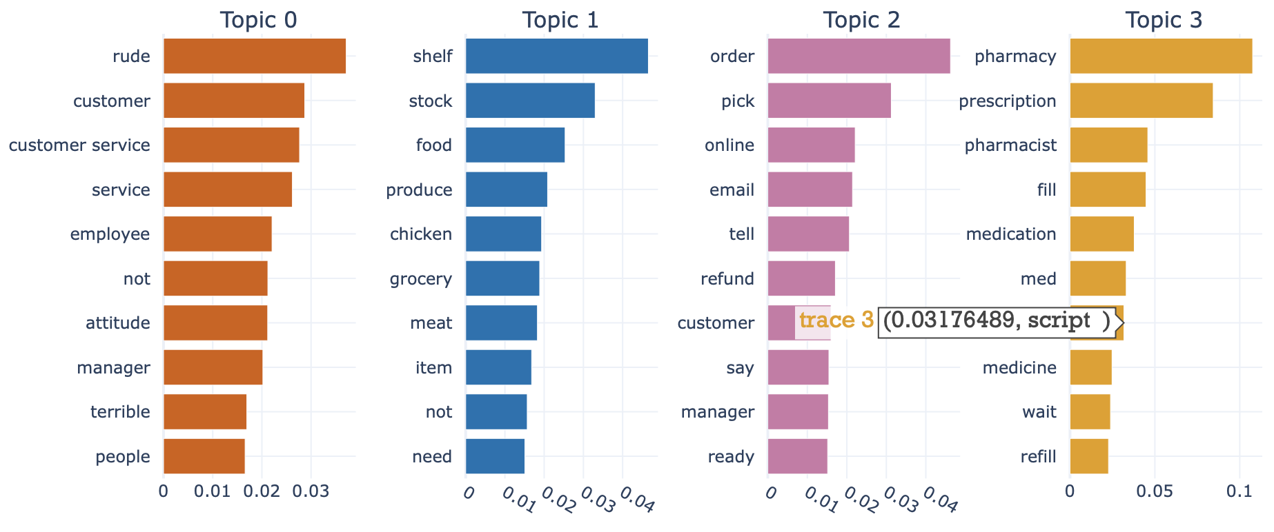
Walmart: BERT Analysis with Zero Shot (4/6)
Checkout Delays: High frustration from slow lines and self-checkout issues.
Customer Service Failures: Repeated reports of rude and unhelpful staff.
Cleanliness Problems: Dirty restrooms and store areas impacting customer satisfaction.
Stock & Inventory Issues: Missing items and out-of-stock products.
Pharmacy Wait Times: Delays in prescription services.
Security Concerns: Complaints about safety and theft prevention.
Zero-Shot Topic Modeling validates consistent retail challenges, confirming that customer feedback aligns with predefined risk areas for proactive intervention.

Slide 27
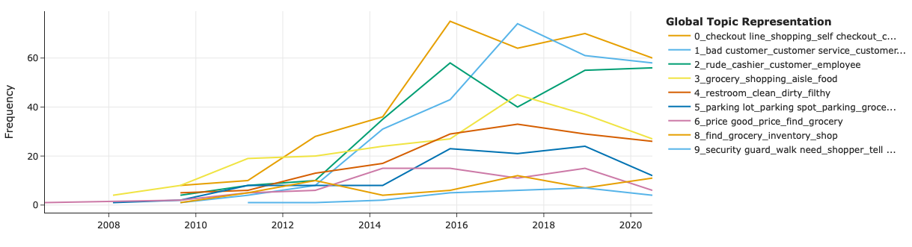
Walmart: BERT Analysis with Zero Shot (5/6)
Persistent Operational Issues – Checkout, staffing, and stock challenges have remained consistent over time.
Rising Concerns – Security and inventory management have become growing focal points.
Predictable Risk Areas – Recurring customer pain points indicate early warning signs for store decline.

Slide 28
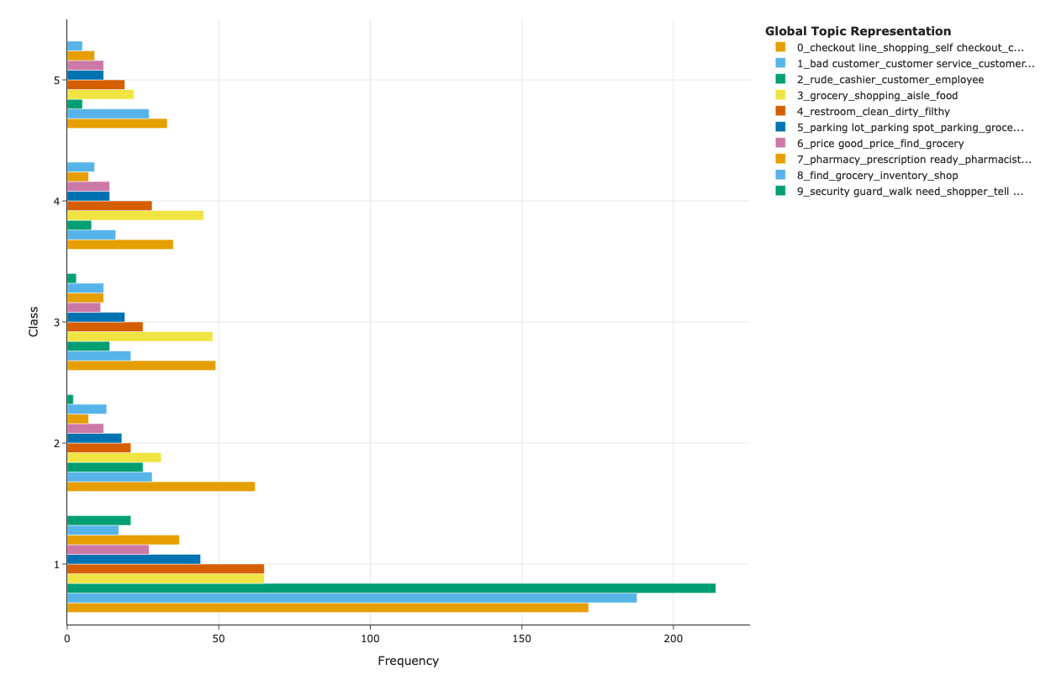
Walmart: BERT Analysis with Zero Shot (6/6)
1-Star Ratings (most frequent) is dominated by:
Inventory Issues (Topic 8) – reflecting widespread complaints about stock and availability.
Checkout Delays (Topic 0) – confirming persistent frustration with long lines and self-checkout.
Customer Service (Topic 1) – highlighting consistent dissatisfaction with staff behavior.
Higher Stars (3, 4, 5) show:
Gradual distribution of topics like Cleanliness (Topic 4) and Security Concerns (Topic 9).
Fewer total reviews but cover more specific or severe complaints.
Security (Topic 9) and Pharmacy Issues (Topic 7) are present across classes but at lower frequencies, indicating localized issues rather than system-wide problems.
The majority of recurring complaints are centered on everyday operational issues (stock, checkout, service).
Higher severity classes capture more critical or niche issues, which may indicate at-risk locations.

Slide 29
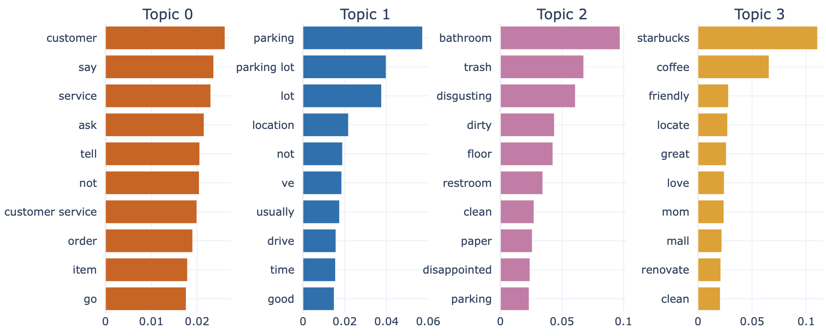
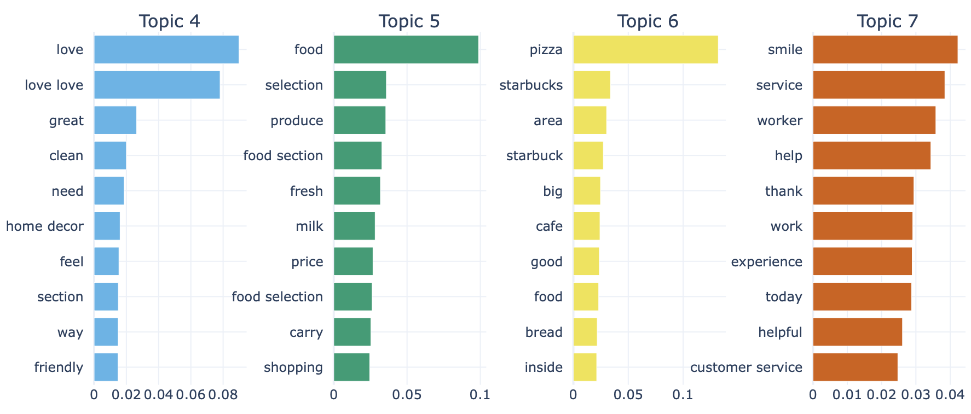
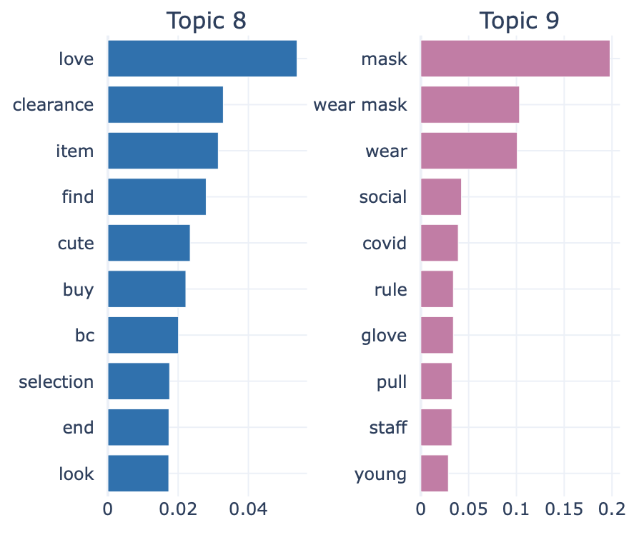
Target: BERT Analysis (1/6)
We identified 10 major recurring themes from Target customer reviews:
Service Issues: communication gaps, lack of helpful staff, inconsistent support (Topic 0, Topic 7)
Parking Challenges: limited parking availability, inconvenient locations (Topic 1)
Cleanliness & Restrooms: dirty bathrooms, unclean floors, disappointing hygiene (Topic 2)
Starbucks Experience: mixed reviews on in-store coffee, food quality, and service (Topic 3, Topic 6)
Home Decor & Store Layout: positive mentions of clean sections, home decor variety (Topic 4)
Food Quality & Selection: fresh produce, food variety, and competitive pricing (Topic 5)
Clearance & Product Availability: good deals on clearance items, finding specific products (Topic 8)
COVID-19 Protocols: mask policies, social distancing enforcement (Topic 9)
Positive Shopping Experience: mentions of friendliness, enjoyable store ambiance (spread across Topics 3, 4, 7)
Target's key pain points include service quality, parking, cleanliness, and product experience, with Starbucks and pandemic safety as unique themes.
Notes:
Additional Insights (for your notes or speaking points):
🔹 Dominance of Service-Related Complaints: Topics 0 and 8 both emphasize customer service and staff behavior, signaling that people are repeatedly frustrated by interactions with employees — this can be a leading indicator of operational decline.
🔹 Operational Gaps Across the Board: There’s a spread across inventory management (Topic 1), order fulfillment (Topic 2), pharmacy services (Topic 3), and store maintenance (Topics 4, 7). This suggests that store problems are not isolated, but systemic.
🔹 Facilities and Experience Matter: Topics on parking (Topic 5) and checkout (Topic 6) highlight how even external or logistical factors influence customer satisfaction.
🔹 Minimal Positive Sentiment: Topic 9 has small positive mentions ("love", "price") but is insignificant compared to the weight of negative topics. This imbalance could correlate with stores at higher risk.
Additional Insights (for your notes or speaking points):
🔹 Dominance of Service-Related Complaints: Topics 0 and 8 both emphasize customer service and staff behavior, signaling that people are repeatedly frustrated by interactions with employees — this can be a leading indicator of operational decline.
🔹 Operational Gaps Across the Board: There’s a spread across inventory management (Topic 1), order fulfillment (Topic 2), pharmacy services (Topic 3), and store maintenance (Topics 4, 7). This suggests that store problems are not isolated, but systemic.
🔹 Facilities and Experience Matter: Topics on parking (Topic 5) and checkout (Topic 6) highlight how even external or logistical factors influence customer satisfaction.
🔹 Minimal Positive Sentiment: Topic 9 has small positive mentions ("love", "price") but is insignificant compared to the weight of negative topics. This imbalance could correlate with stores at higher risk.
Additional Insights (for your notes or speaking points):
🔹 Dominance of Service-Related Complaints: Topics 0 and 8 both emphasize customer service and staff behavior, signaling that people are repeatedly frustrated by interactions with employees — this can be a leading indicator of operational decline.
🔹 Operational Gaps Across the Board: There’s a spread across inventory management (Topic 1), order fulfillment (Topic 2), pharmacy services (Topic 3), and store maintenance (Topics 4, 7). This suggests that store problems are not isolated, but systemic.
🔹 Facilities and Experience Matter: Topics on parking (Topic 5) and checkout (Topic 6) highlight how even external or logistical factors influence customer satisfaction.
🔹 Minimal Positive Sentiment: Topic 9 has small positive mentions ("love", "price") but is insignificant compared to the weight of negative topics. This imbalance could correlate with stores at higher risk.

Slide 30
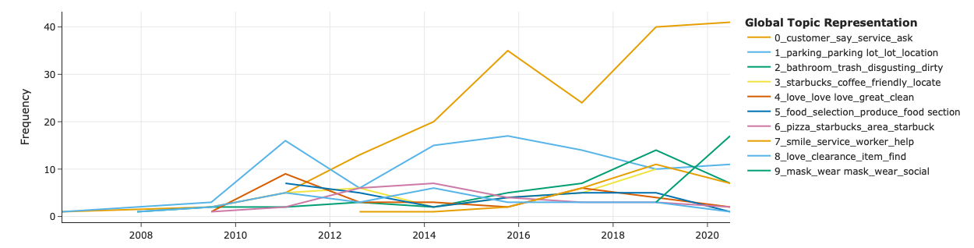
Target: BERT Analysis (2/6)
How Customer Complaints Have Shifted Over Tim:
Persistent Service & Cleanliness Issues – Customer service complaints have steadily grown, while restroom and store cleanliness concerns show periodic spikes.
Parking & Food Selection – Parking peaked as a major issue around 2011 before stabilizing, while food selection and freshness have remained a consistent topic.
Shifting Sentiments on Starbucks & COVID-19 – In-store Starbucks experiences have fluctuated over time, while mask policies gained traction post-2020 due to pandemic-related concerns.
Notes:
How Customer Complaints Have Shifted Over Time
Customer Service Complaints (Topic 0) – Consistent mentions from the start, with steady growth, reflecting ongoing dissatisfaction with staff support and service interactions.
Parking Challenges (Topic 1) – Saw early growth peaking around 2011, then stabilized, showing parking has been a longstanding concern.
Cleanliness & Restroom Issues (Topic 2) – Periodic spikes, highlighting that store cleanliness and restroom conditions have been a recurring pain point.
Starbucks In-Store Experience (Topic 3, Topic 6) – Fluctuating mentions over the years, signaling varying customer sentiment about in-store cafes and food options.
Store Environment & Home Decor Love (Topic 4) – Significant growth post-2014, peaking around 2020, reflecting increased positive feedback on store aesthetics and decor sections.
Food Selection & Freshness (Topic 5) – Moderate presence, with minor peaks over time, pointing to consistent interest in food variety and quality.
COVID-19 Mask Policies (Topic 9) – Noticeable increase in recent years (post-2020), tied to pandemic safety measures and customer feedback on mask enforcement.

Slide 31
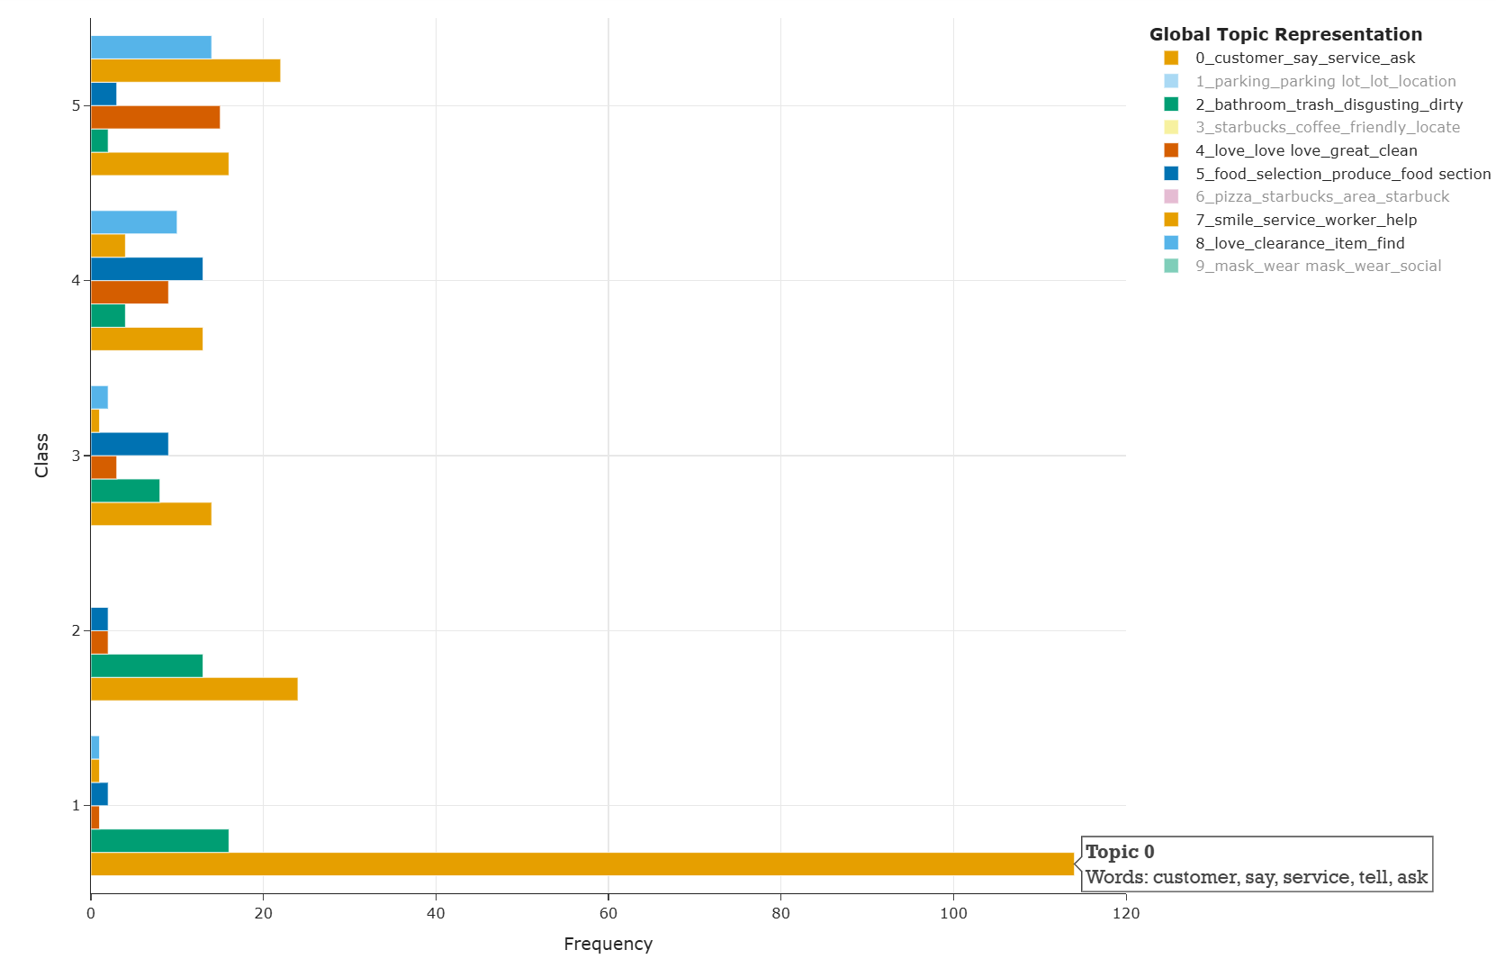
Target: BERT Analysis (3/6)
Distribution of Topics Across Review Classes
Class 1 dominates the dataset, with the highest frequency of reviews mentioning: Customer Service Issues (Topic 0) Clearance & Product Availability (Topic 8) COVID-19 Mask Policies (Topic 9)
Higher Classes (4 & 5) show a more balanced mix of topics but with lower frequencies, indicating fewer but likely more experience-based or positive feedback, such as: Starbucks Experience (Topic 3) Home Decor Love (Topic 4) Friendly Staff (Topic 7)
Parking Issues (Topic 1) and Cleanliness Problems (Topic 2) appear consistently across classes, reinforcing them as ongoing, widespread concerns impacting overall satisfaction.

Slide 32



Target: BERT Analysis with Zero Shot (4/6)
Checkout Delays: Frustration around long lines, slow self-checkout processes, and crowded aisles.
Stock & Inventory Issues: Challenges in finding grocery items, missing products, and limited availability.
Cleanliness Problems: Dirty restrooms, unorganized areas, and poor store maintenance affecting the shopping experience.
Customer Service Failures: Reports of rude employees, unhelpful cashiers, and poor handling of returns and complaints.
Parking Difficulties: Limited parking spaces and inconvenient parking lot layouts, especially during busy times.
Pharmacy Wait Times: Delays in service, difficulty finding medications, and issues with pharmacy staff.
Security Concerns: Feedback around mask enforcement, social distancing, safety incidents, and staff response during COVID-19.
Price & Affordability: Comments around sales, pricing, and value for money.
Zero-Shot modeling confirms that:
Retail Pain Points Are Consistent – Customer frustrations align with common industry issues.
Predictable & Recurring Issues – Service, inventory, cleanliness, and safety concerns persist over time.
Need for Proactive Action – Early interventions can enhance operations, staff performance, and customer satisfaction.

Slide 33

Target: BERT Analysis with Zero Shot (5/6)
Checkout experience, stock shortages, and cleanliness have grown as persistent issues over the years.
Customer service and parking remain steady, long-term areas of concern.
COVID-19 safety measures created a clear spike in recent feedback.
Notes:
Checkout & Shopping Experience (Topic 0) – Steady growth from 2007, peaking around 2019, reflecting ongoing frustrations with checkout processes, crowded aisles, and general shopping flow.
Stock & Inventory Issues (Topic 1) – Rapid increase from 2010 to 2014, maintaining high levels through recent years, signaling persistent problems with product availability and grocery section shortages.
Cleanliness Problems (Topic 2) – Noticeable growth from 2012 to 2018, showing rising concerns over restrooms, cleanliness, and store maintenance.
Customer Service Complaints (Topic 3) – Gradual rise, peaking around 2017, highlighting long-standing dissatisfaction with employee interactions and assistance.
Parking Lot Issues (Topic 4) – Consistent presence over time, reinforcing the difficulty customers face with parking access and convenience.
COVID-19 Safety Concerns (Topic 9) – Sharp growth post-2020, focusing on mask enforcement, safety protocols, and social distancing in stores.
Price & Value Feedback (Topic 7) – Increase over time, as customers regularly mention sales, affordability, and product pricing.

Slide 34

Target: BERT Analysis (6/6)
Distribution of Topics Across Review Classes (Stars)
1-Star Ratings dominates the dataset, with the highest frequency of reviews mentioning: Rude Cashier/Other Employees (Topic 2) Bad Customer Service (Topic 1) Long Checkout Line (Topic 9)
Higher Stars (4 & 5) show a more balanced mix of topics but with lower frequencies, indicating fewer but likely more experience-based or positive feedback, such as: Moderate-Good Grocery Prices (Topic 6) Experiencing Neat Aisle (Topic 3)

Slide 35

Walmart: NLP Insights & Business Impact
Key Findings from Customer Reviews
Service Quality Issues
Stock & Inventory Problems
Online Order & Pickup Challenges
Store Cleanliness & Environment
Security & Safety Complaints
Business Impact & Store Viability Risks
Declining Customer Satisfaction
Operational Inefficiencies
Reputation Damage
Early Warning Signals for Closures
NLP reveals critical operational pain points at Walmart, signaling risks to customer satisfaction and store survival.

Slide 36
Target: NLP Insights & Business Impact
Key Findings from Customer Reviews
Service Quality Issues
Parking Challenges
Store Cleanliness & Restrooms
Starbucks & In-Store Experience
COVID-19 Safety & Mask Policies
Business Impact & Store Viability Risks
Customer Experience & Brand Perception
Operational Challenges in High-Traffic Locations
Store Maintenance & Hygiene Standards
Impact of In-Store Amenities on Foot Traffic
Pandemic-Driven Policy Sentiment
NLP highlights Target’s operational challenges, focusing on service quality, amenities, and pandemic-driven customer expectations.

Slide 37


Limitations of NLP Approach
(1)
Data & Bias Challenges
(2)
Sentiment & Language Limitations
(3)
Business Relevance Constraints
(4)
External Influences Not Captured
NLP insights are powerful but limited by data biases, language nuances, and external business factors.
Notes:
Data & Bias Challenges
Review Bias – Yelp reviews may not represent all customers, as people with extreme experiences are more likely to post.
Regional Variation – Customer sentiment may vary by location, making it difficult to generalize findings.
2️⃣ Sentiment & Language Limitations
Context Misinterpretation – Sentiment analysis may misread sarcasm, mixed opinions, or nuanced feedback.
Keyword Dependence – Models rely on word patterns, which may not capture the full meaning of a review.
3️⃣ Business Relevance Constraints
Lack of Operational Data – The analysis does not include store-level financials, foot traffic, or sales figures.
Delayed Feedback Cycle – Reviews reflect past experiences and may not capture real-time improvements in stores.
4️⃣ External Influences Not Captured
Market & Economic Factors – External trends like inflation, local economic downturns, or competitor expansions are not considered but can impact store viability.

Slide 38

Recommendations for Walmart & Target
(1)
Improve Service Quality & Staff Training
(2)
Optimize Inventory & Supply Chain Management
(3)
Enhance Store Cleanliness & Maintenance
(4)
Address Parking & In-Store Experience
(5)
Strengthen Security & Loss Prevention Measures
(6)
Leverage NLP for Continuous Monitoring & Intervention
Strategic improvements in service, operations, and safety can drive better customer experiences and store performance.
Notes:
Improve Service Quality & Staff Training
Invest in customer service training to address complaints about staff behavior and checkout delays.
Implement real-time feedback systems to monitor service quality and take corrective action.
2️⃣ Optimize Inventory & Supply Chain Management
Use predictive analytics to minimize stock shortages and ensure product availability.
Strengthen inventory tracking to reduce order fulfillment delays and pickup issues.
3️⃣ Enhance Store Cleanliness & Maintenance
Standardize cleaning protocols to address persistent restroom and store hygiene concerns.
Conduct routine audits to maintain high cleanliness and organization standards.
4️⃣ Address Parking & In-Store Experience
Optimize store layouts and parking space allocation to improve accessibility.
Enhance in-store amenities (e.g., Starbucks, food courts) to attract more customers.
5️⃣ Strengthen Security & Loss Prevention Measures
Expand security presence and monitoring in stores with high theft complaints.
Train staff in conflict resolution and emergency response to improve customer safety.
6️⃣ Leverage NLP for Continuous Monitoring & Early Intervention
Develop an automated dashboard tracking real-time sentiment trends across stores.
Use predictive insights from NLP to implement proactive, store-specific interventions before issues escalate.

Slide 39

Implementation Strategy
Short-Term (0-2 Years)
Improve Service & Cleanliness – Train staff, enforce hygiene standards, and track customer complaints.
Optimize Inventory & Order Fulfillment – Use data to prevent stock shortages and streamline pickup.
Deploy Sentiment-Based Monitoring – Flag at-risk stores using NLP insights for early intervention.
Long-Term (+2 Years)
Automate Store Risk Assessment – Implement AI-driven models for continuous monitoring.
Integrate NLP with Operations – Align sentiment insights with financial and operational data.
Refine Models with New Data – Continuously update predictions as customer trends evolve.
A phased strategy combining short-term improvements and long-term AI-driven monitoring ensures sustained store performance.

Slide 40

Financial Impact Analysis & Assumptions
Metric | Value ($) | Formula / Assumption
Total Potential Revenue Loss Avoided | $750,000,000 | (Avg. revenue per store $50M) × (Revenue loss 15%) × (At-risk stores 100)
Total Store Closure Costs Avoided | $500,000,000 | (Closure cost per store $5M) × (At-risk stores 100)
Total Potential Savings | $1,250,000,000 | (Total Revenue Loss Avoided) + (Total Store Closure Costs Avoided)
Short-Term Implementation Cost (0-2 Years) | $50,000,000 | (Cost per store $500K) × (At-risk stores 100)
Long-Term Implementation Cost (+2 Years) | $30,000,000 | (Cost per store $300K) × (At-risk stores 100)
Total Implementation Cost | $80,000,000 | (Short-Term Cost) + (Long-Term Cost)
Net Present Value (NPV) | $886,574,074 | (Total Potential Savings) discounted at 8% over 2 and 5 years - (Total Implementation Cost)
Return on Investment (ROI) (%) | 1462.50% | ((Total Potential Savings - Total Implementation Cost) / Total Implementation Cost) × 100
This hypothetical model illustrates the thought process behind estimating potential savings and intervention costs for at-risk stores.

Slide 41
Thank you, have fun in Spring Break!!!

